Slide 1
Window Forms
Presented By :Er.Sudan Prajapati

Slide 2
Context Menu Strip Control
The ContextMenuStrip control provides functionality of context menus in Visual Studio.
A context menu is also known as a popup menu.
A context menu is a group of commands or menu items that can be accessed by right-clicking on the control surface.
It usually contains some frequently used commands for example Cut, Copy and Paste in a text editor.
In Windows Forms, a context menu is created using the ContextMenuStrip control and its command

Slide 3
Creating a Context Menu in Design view
Create a new Windows Forms application and drag a ContextMenuStrip control onto the form
Type the name of the menu item in the ComboBox labeled with "Type Here" and press Enter. For example, type "Exit" and press Enter
Double-click on the menu item (Exit) to write code for its Click event. Write the following in its Click event: private void exitToolStripMenuItem_Click(object sender, EventArgs e){
Application.Exit();}

Slide 4
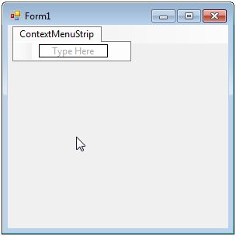
Context Menu Strip
NOTE:
To change images on this slide, select a picture and delete it. Then click the Insert Picture icon
in the placeholder to insert your own image.

Slide 5
Add image to Context Menu items
The Image property of ToolStripMenuItem is used to add an image to a menu item.
In design view, select the menu item and go to its property and click the ellipsis next to the Image property and select image from the Local Resource or Project Resource File.

Slide 6
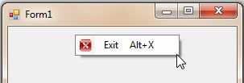
Add shortcut keys to Context Menu items
In design view, use the ShorcutKeys property to set shortcuts to the menu items.
Select your prefered combination of keys by using CheckBoxes for Modifiers (Ctrl, Alt and Shift) and selecting Key from the ComboBox.
For example, to bind shortcut the "Alt+X" to Exit, select Alt CheckBox from Modifiers and select X from the Key ComboBox.

Slide 7
Type of items in ContextMenuStrip
MenuItem (ToolStripMenuItem) It is used to give a simple menu item like "Exit" in the above example.
ComboBox (ToolStripComboBox) It is used to insert a ComboBox in the context menu where the user can select or type an item in the ComboBox.
Separator (ToolStripSeparator) It is used to put a horizontal line (ruler) between menu items.
TextBox (ToolStripTextBox) It is used to put a TextBox in the context menu where the user can enter an item.

Slide 8
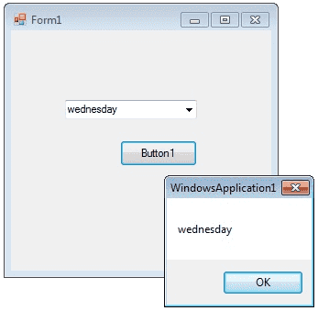
ComboBox Control
A ComboBox displays a text box combined with a ListBox, which enables the user to select items from the list or enter a new value .
The user can type a value in the text field or click the button to display a drop down list.
individual objects can also be added with the Add method.
User can delete items with the Remove method or clear the entire list with the Clear method

Slide 9
Add Code
private void Form1_Load(object sender, EventArgs e) {
comboBox1.Items.Add("Sunday");
comboBox1.Items.Add("Monday");
comboBox1.Items.Add("Tuesday");
comboBox1.Items.Add("wednesday");
comboBox1.Items.Add("Thursday");
comboBox1.Items.Add("Friday");
comboBox1.Items.Add("Saturday");
ComboBox1.SelectedIndex = comboBox1.FindStringExact("Sunday"); }
}

Slide 10
Combobox SelectedIndexChanged event
The SelectedIndexChanged event of a combobox fire when you change the slected item in a combobox.
If you want to do something when you change the selection, you can write the program on SelectedIndexChanged event.
From the following code you can understand how to set values in the SelectedIndexChanged event of a combobox.
Drag and drop two combobox on the Form and copy and paste the following source code.

Slide 11
Add Code Below
private void Form1_Load(object sender, EventArgs e) {
comboBox1.Items.Add("weekdays");
comboBox1.Items.Add("year"); }
private void comboBox1_SelectedIndexChanged(object sender, EventArgs e) {
comboBox2.Items.Clear();
if (comboBox1.SelectedItem == "weekdays") {
comboBox2.Items.Add("Sunday");
comboBox2.Items.Add("Monday");}
else if (comboBox1.SelectedItem == "year") {
comboBox2.Items.Add("2012");
comboBox2.Items.Add("2013"); } }

Slide 12
Status Bar
StatusBar control is not available in Toolbox of Visual Studio 2010.
StatusStrip control replaces StatusBar in Visual Studio 2010. But for backward compatibility support, StatusBar class is available in Windows Forms
A StatusBar control is a combination of StatusBar panels where each panel can be used to display different information. For example, one panel can display current application status and other can display date and other information and so on.
A typical StatusBar sits at the bottom of a form.

Slide 13
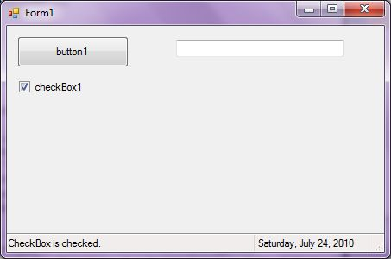
Status Bar

Slide 14
ADD Code
private void Form1_Load(object sender, EventArgs e)
{ toolStripStatusLabel1.Text = "DateTime: " + System.DateTime.Today.ToString();
}

Slide 15
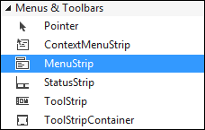
Menus Control
Start a new project by clicking File > New Project from the menu at the top of Visual C#.
Create a new Windows Application project.
Call it anything you like.
When your new form appears, you can add a menu bar from tool box

Slide 16
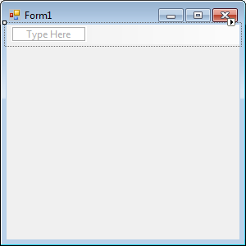
Menus Control
Double click MenuStrip and you'll see a menu bar appear at the top of your form:

Slide 17
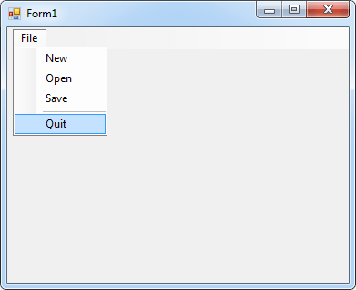
Menus Control

Slide 18

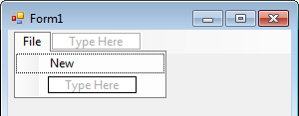
Menus Control
Adding items to your menus is quite simple.
Click inside of the area at the top, where it says "Type Here".
Type the word File.
Hit the Enter key on your keyboard and your menu will look like this:

